Slide 1
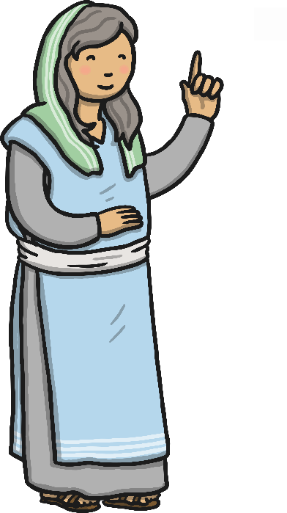
The Holy Rosary Mary’s Prayer

Slide 2
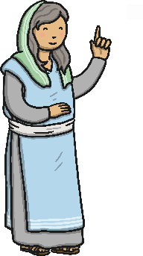
What Is the Holy Rosary?
The Rosary is a form of prayer used especially in the Catholic Church.
It is a long prayer, based on repetition, with many parts to be remembered and said.
It is named after the string of prayer beads which some people use to count the parts of the prayer.
The Rosary Prayer is very important to Catholics for many reasons, including their devotion to Mary.
The Rosary Prayer can be said alone or in groups.
Praying a Rosary for the dead is part of the funeral tradition.

Slide 3
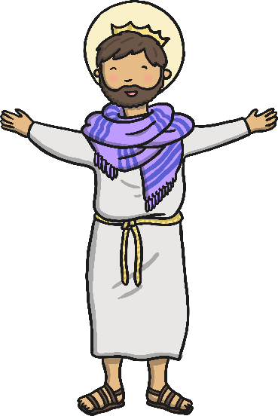
What Is the Purpose of the Rosary?
The purpose of the Rosary is to help people remember the events in the lives of Jesus and Mary and to thank and praise God for them.
The Rosary Prayer is a little bit like a history lesson!
The main focus is on Jesus - his birth, life, death and resurrection.

Slide 4
The Rosary Prayer
The main parts of the Rosary Prayer are:
1. Sign of the Cross
In the name of the Father and of the Son and of the Holy Spirit. Amen
2. The Our Father Prayer
Our Father, Who art in Heaven; hallowed be Thy name; Thy kingdom come; Thy will be done on Earth as it is in Heaven. Give us this day our daily bread; and forgive us our trespasses as we forgive those who trespass against us, and lead us not into temptation; but deliver us from evil. Amen

Slide 5
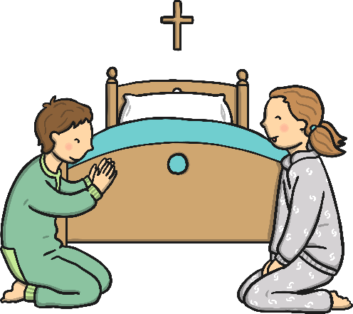
The Rosary Prayer Cont.
3. The Hail Mary Prayer (three times)
Hail Mary, full of grace, the Lord is with thee; blessed art thou among women and blessed is the fruit of thy womb, Jesus. Holy Mary, Mother of God, pray for us sinners, now and at the hour of our death. Amen
4. The Glory Be to the Father
Glory be to the Father, and to the Son, and to the Holy Spirit, as it was in the
beginning, is now, and ever shall be, world without end. Amen
5. The Our Father Prayer
6. The Hail Mary Prayer (ten times)
7. The Glory Be to the Father

Slide 6
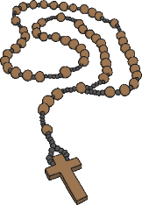
What Are Rosary Beads?
The Rosary Beads provide a method of keeping count of the different parts of the Rosary Prayer.
The fingers are moved along the beads as the prayers are said.
By not having to keep track of the count mentally, the mind is free to meditate.
The Roman Catholic Rosary is made up of a cross or crucifix, a medal, large beads and small beads.
Some sets of Rosary Beads have five groups of ten beads and other sets of Rosary Beads contain fifteen groups of ten beads.
The prayers of the Rosary can also be said using any type of counting device or by counting on the fingers.
?

Slide 7
Using The Rosary Beads
7
1. Sign of the Cross
2. The Our Father Prayer
3. The Hail Mary Prayer (x3)
4. The Glory Be to the Father
5. The Our Father Prayer
6. The Hail Mary Prayer (x10)
7. The Glory Be to the Father
6
3
5
4
2
1

Slide 8
The Mysteries of The Rosary
The Rosary Prayer focuses on the life of Christ from the Bible.
During these prayers, people meditate on different aspects of Christ’s life.
The beads of the Rosary are divided into five decades (or sections); each decade represents an event from the life of Christ.
These five events are grouped into a set of four mysteries, each focused on an important part of the life of Christ.
The four mysteries are named after the type of events in that mystery:
Joyful - The Nativity
Luminous - The Baptism of the Lord
Sorrowful - The Crucifixion
Glorious - The Resurrection
Challenge: Can you find out some more of the life events in each mystery?

Slide 9
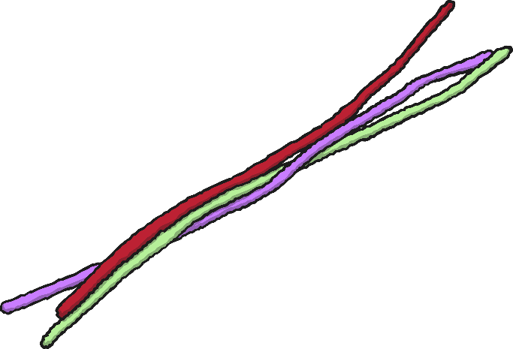
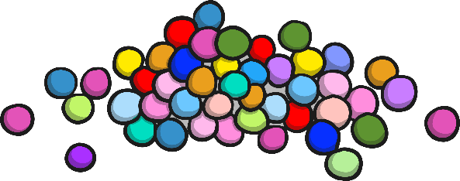
Make Your Own Rosary
You will need:
Pipe cleaners
Small craft beads
Scissors
Place 10 beads of your choice onto a pipe cleaner.
Bring the pipe cleaner around into a circle and twist it shut.
Place on one more bead for the Our Father.
Cut off the extra piece and twist it around to make the cross.
Trim off the excess where necessary.

