Slide 1
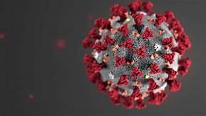
COVID-19
Presentation About COVID-19 And Effect On Our Lives

Slide 2
COVID-19
COVID-19 is a deadly virus that started in Wuhan, China
It is believed the virus was caused by an animal (Bat) and in some way ingested by human consumption.
The Virus has total of 6.5m reported infections
382k reported deaths to date
Scientists are currently working on a vaccine

Slide 3
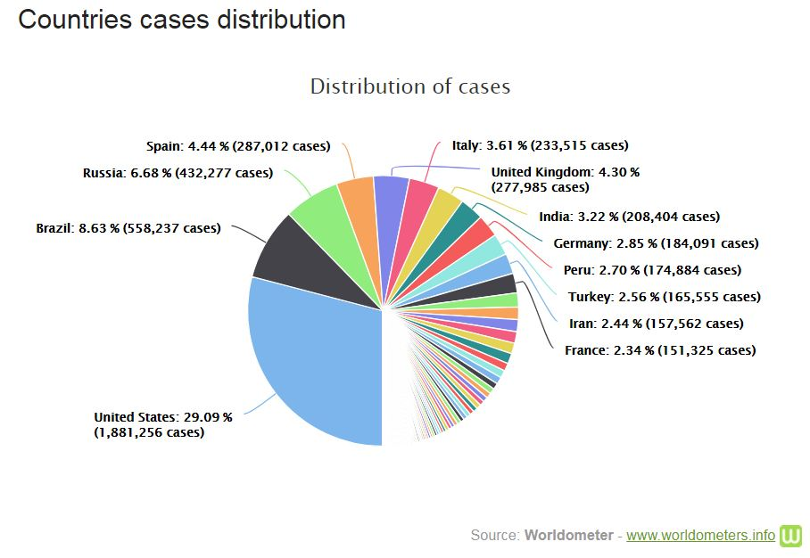
Countries affected by COVID-19

Slide 4
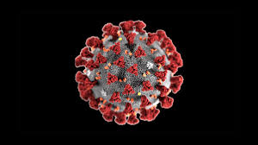
How COVID-19 has impacted our daily lives
COVID-19 has a big impact on our or daily lives such as:
No sports
No school
No social gatherings
Queue’s at food stores
Wearing PPE
Higher risk of mental illness
Constant hand hygiene awareness/sanitising

Slide 5
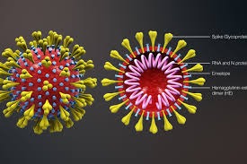
What's Next
Follow guide lines
Social distancing
Frequently wash your hands
Monitor updates
STAY HOME AND STAY SAFE ☺

